Slide 1
Version Control with Git, GitHub, & Git Annex The lab notebook for the digital world Donders HPC virtual workshop 4 29-01-2021 Saige Rutherford
git-annex

Slide 2
Road Map
Brief introduction
Glossary (GitHub 101)
A few habit building tips. How to integrate version control into your daily workflow.
Intermission. Optional yoga.
Examples of GitHub repository “recipes”. Simple, intermediate, & complex
Version control of large files with git-annex

Slide 3
@being_saige
www.beingsaige.com

Slide 4
Good Data Management is Good Research Practice
Data are everywhere in research. If you are performing any sort of study, in any field of science, you will be generating data files. These files will then be used in your analyses and in your grant applications. Given how important the actual data files are, it is a shame that we as scientists don’t get more training in how to manage our data. While we often have excellent data analysis training, we usually have no training at all in how to organize data, how to build processing streams for our data, and how to curate and document our data so that future researchers can use it.
However, researchers are not rewarded for being excellent at managing data. Reviewers are never going to say how beautifully a dataset is documented and you will never get back a summary statement from the NIH commenting on the choice of comma delimited vs tab delimited files. Quite frankly, if you do manage your data well, your reward will be the lack of comments. You will know you did well if you can send a single link to a new collaborator to your data set, and they respond with, “Everything looks like it is here, and the documentation answered all of my questions.” So, given that lack of extrinsic motivation, why should you take the time and effort to learn and practice good data management?
Credit: https://www.teaguehenry.com/strings-not-factors/2021/1/24/data-management-for-researchers-three-terrifying-tales

Slide 5
“Version control is the lab notebook of the digital world: it’s what professionals use to keep track of what they’ve done and to collaborate with other people. Every large software development project relies on it, and most programmers use it for their small jobs as well. And it isn’t just for software: books, papers, small data sets, and anything that changes over time or needs to be shared can and should be stored in a version control system.”

Slide 6
WARNING: I AM NOT AN EXPERT.
I’m on a learning journey too.
I use Mac OS & Linux (via the DCCN server), I haven’t used a Windows computer in 15+ years so I can’t help with Windows ☹
https://docs.github.com/en/github

Slide 8
This workshop assumes you have some minimum knowledge of git.
If you have never heard of git or GitHub, you might feel a little lost.
Here are some excellent learning resources to help you learn the basics.
Even if you are a git-wizard, these resources can help you teach others!
http://swcarpentry.github.io/git-novice/reference
https://docs.github.com/en

Slide 9
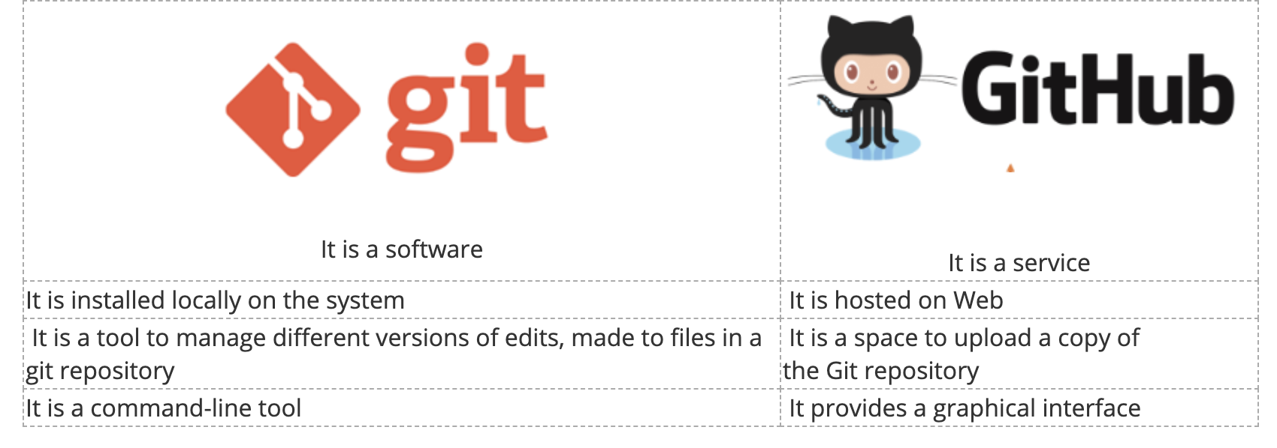
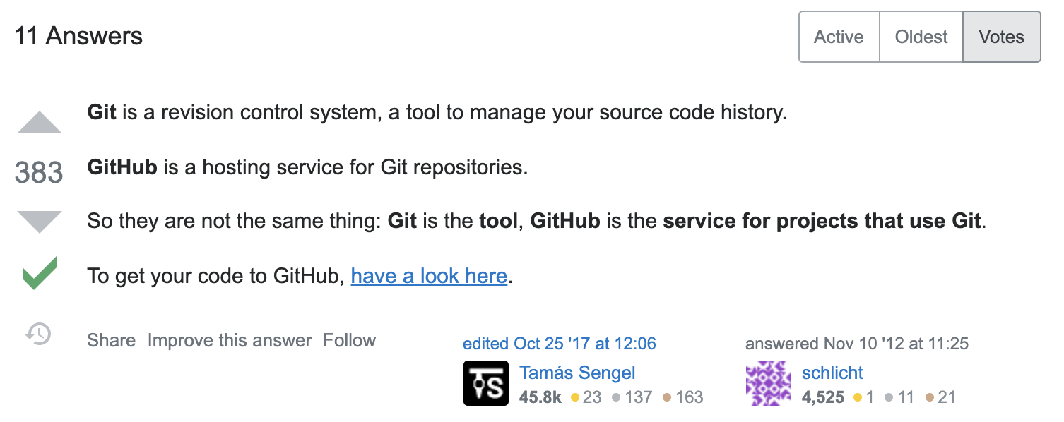
Open-source software
Owned by Microsoft. Free to sign up for an account, but there is a “Pro” option which costs $4 per month
git-annex
git-annex allows managing files with git, without checking the file contents into git. While that may seem paradoxical, it is useful when dealing with files larger than git can currently easily handle, whether due to limitations in memory, time, or disk space.
https://git-annex.branchable.com/

Slide 10
Two main concepts
commit: a recorded set of changes in your project’s files
repository: the history of all your project’s commits. Often called “repo”
commit
A commit, or "revision", is an individual change to a file (or set of files). When you make a commit to save your work, Git creates a unique ID (a.k.a. the "SHA" or "hash") that allows you to keep record of the specific changes committed along with who made them and when. Commits usually contain a commit message which is a brief description of what changes were made.
repository
A repository is the most basic element of GitHub. They're easiest to imagine as a project's folder. A repository contains all the project files (including documentation) and stores each file's revision history. Repositories can have multiple collaborators and can be either public or private.

Slide 11
branch
A branch is a parallel version of a repository. It is contained within the repository but does not affect the primary or main branch allowing you to work freely without disrupting the "live" version. When you've made the changes you want to make, you can merge your branch back into the main branch to publish your changes.
clone
A clone is a copy of a repository that lives on your computer instead of on a website's server somewhere, or the act of making that copy. When you make a clone, you can edit the files in your preferred editor and use Git to keep track of your changes without having to be online. The repository you cloned is still connected to the remote version so that you can push your local changes to the remote to keep them synced when you're online.
checkout
You can use git checkout on the command line to create a new branch, change your current working branch to a different branch, or even to switch to a different version of a file from a different branch with git checkout [branchname] [path to file].
fork
A fork is a personal copy of another user's repository that lives on your account. Forks allow you to freely make changes to a project without affecting the original upstream repository. You can also open a pull request in the upstream repository and keep your fork synced with the latest changes since both repositories are still connected.

Slide 13
gitfile
A plain .git file, which is always at the root of a working tree and points to the Git directory, which has the entire Git repository and its meta data.
issue
Issues are suggested improvements, tasks or questions related to the repository. Issues can be created by anyone (for public repositories) and are moderated by repository collaborators. Each issue contains its own discussion thread. You can also categorize an issue with labels and assign it to someone.
main
The default development branch. Whenever you create a Git repository, a branch named main is created, and becomes the active branch. In most cases, this contains the local development, though that is purely by convention and is not required.
master
The default branch in many Git repositories. By default, when you create a new Git repository on the command line a branch called master is created. Many tools now use an alternative name for the default branch. For example, when you create a new repository on GitHub the default branch is called main.
merge
Merging takes the changes from one branch (in the same repository or from a fork) and applies them into another. This often happens as a "pull request" (which can be thought of as a request to merge), or via the command line. A merge can be done through a pull request via the GitHub.com web interface if there are no conflicting changes or can always be done via the command line.
merge conflict
A difference that occurs between merged branches. Merge conflicts happen when people make different changes to the same line of the same file, or when one person edits a file, and another person deletes the same file. The merge conflict must be resolved before you can merge the branches.
Notes:
Show .git in terminal, also show .gitignore file

Slide 15
origin
The default upstream repository. Most projects have at least one upstream project that they track. By default, origin is used for that purpose.
pull
Pull refers to when you are fetching in changes and merging them. For instance, if someone has edited the remote file you're both working on, you'll want to pull in those changes to your local copy so that it's up to date.
pull request
Pull requests are proposed changes to a repository submitted by a user and accepted or rejected by a repository's collaborators.
push
To push means to send your committed changes to a remote repository on GitHub.com. For instance, if you change something locally, you can push those changes so that others may access them.
README
A text file containing information about the files in a repository that is typically the first file a visitor to your repository will see. A README file, along with a repository license, contribution guidelines, and a code of conduct, helps you share expectations and manage contributions to your project.

Slide 17
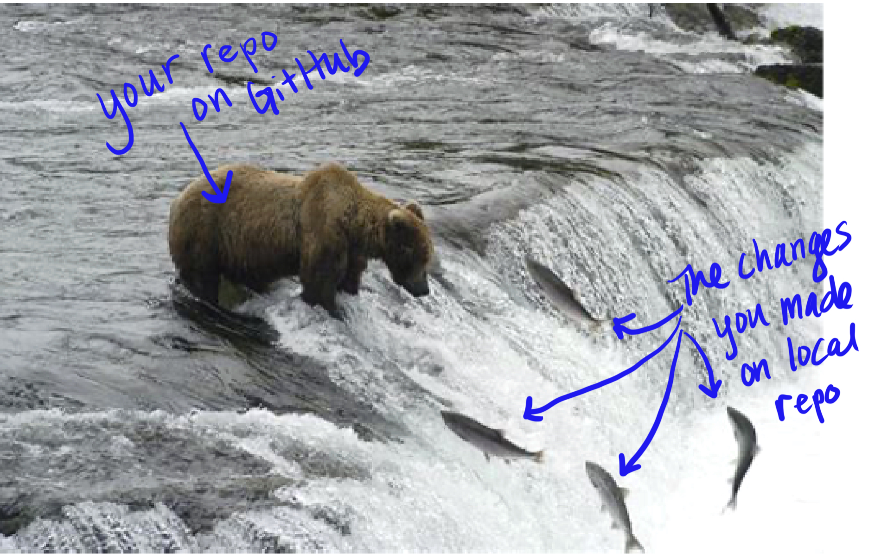
remote
This is the version of a repository or branch that is hosted on a server, most likely GitHub.com. Remote versions can be connected to local clones so that changes can be synced.
SSH key
SSH keys are a way to identify yourself to an online server, using an encrypted message. It's as if your computer has its own unique password to another service. GitHub uses SSH keys to securely transfer information to your computer.
upstream
When talking about a branch or a fork, the primary branch on the original repository is often referred to as the "upstream", since that is the main place that other changes will come in from. The branch/fork you are working on is then called the "downstream". Also called origin.

Slide 19
Tips for using version control daily
🥺
🤩
Is this not the first git workshop you have attended that explains all these strange words like fork, upstream, remote, branch?
But you still can’t remember them, so you have to keep looking them up?
That’s totally normal! It just means that you haven’t made git a habit yet. When you use these commands on a daily basis, they will become like typing in your mom’s phone number or your password to get on the server. You will just know them.
But it can be overwhelming to get started. Maybe you don’t write code every day for your work, or maybe you are used to just putting everything on GitHub at the end of a project when it comes time to publish.
Do you keep a daily to-do list? Or some other text file that you edit on a daily basis?
Try managing it with git!
Notes:
Show your example of productivity repo

Slide 20
INTERMISSION!
Join me for Nadi Shodhana (alternate nostril breathing)
or
take a 7-minute break away from your screen

Slide 21
Setup

Slide 22
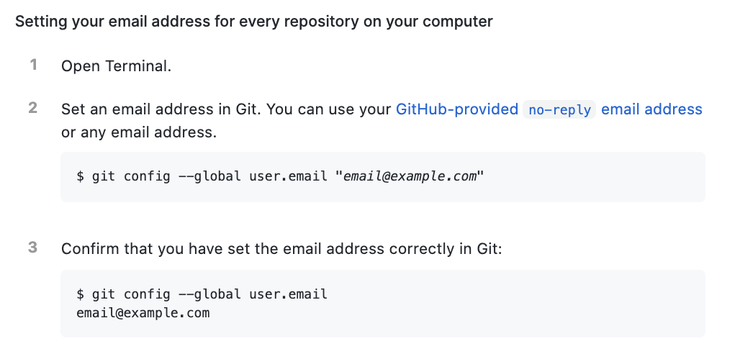
Setup

Slide 23
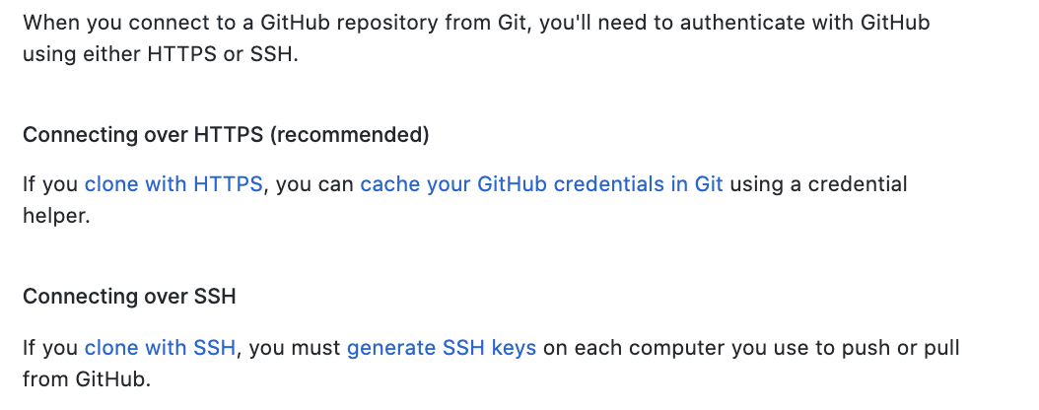
Setup
Using your GitHub account on the DCCN server, you should use SSH

Slide 24
Setup
https://docs.github.com/en/github/authenticating-to-github/generating-a-new-ssh-key-and-adding-it-to-the-ssh-agent
Notes:
Show ssh-keygen, how to add ssh key to profile.

Slide 25
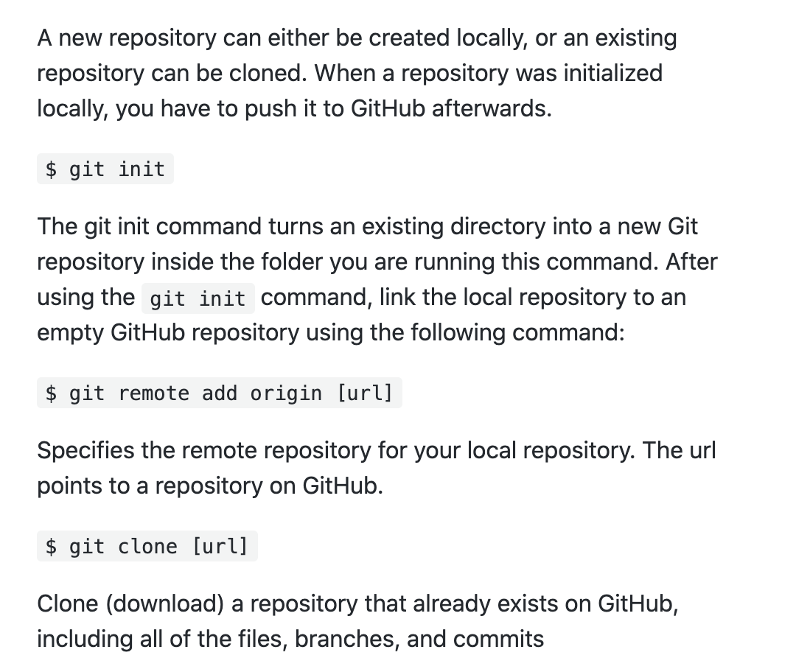
Creating a new repository

Slide 26
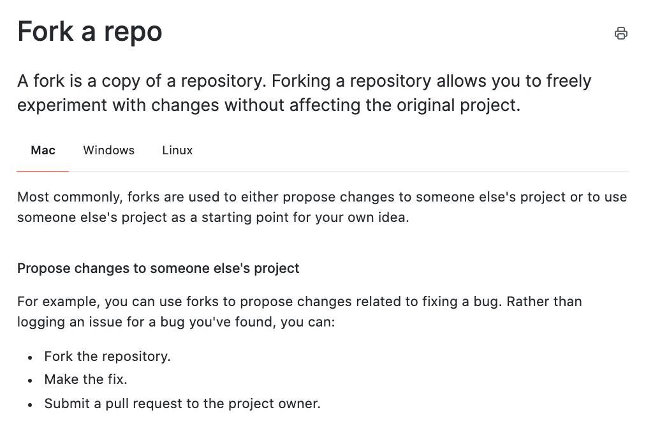
Creating a repository from someone else’s code
Notes:
Make sure you respect the fork. Check if there are contributing guidelines. Usually if it is a large open-source project there will be specific directions for how to contribute and submit a pull request with your changes.

Slide 27
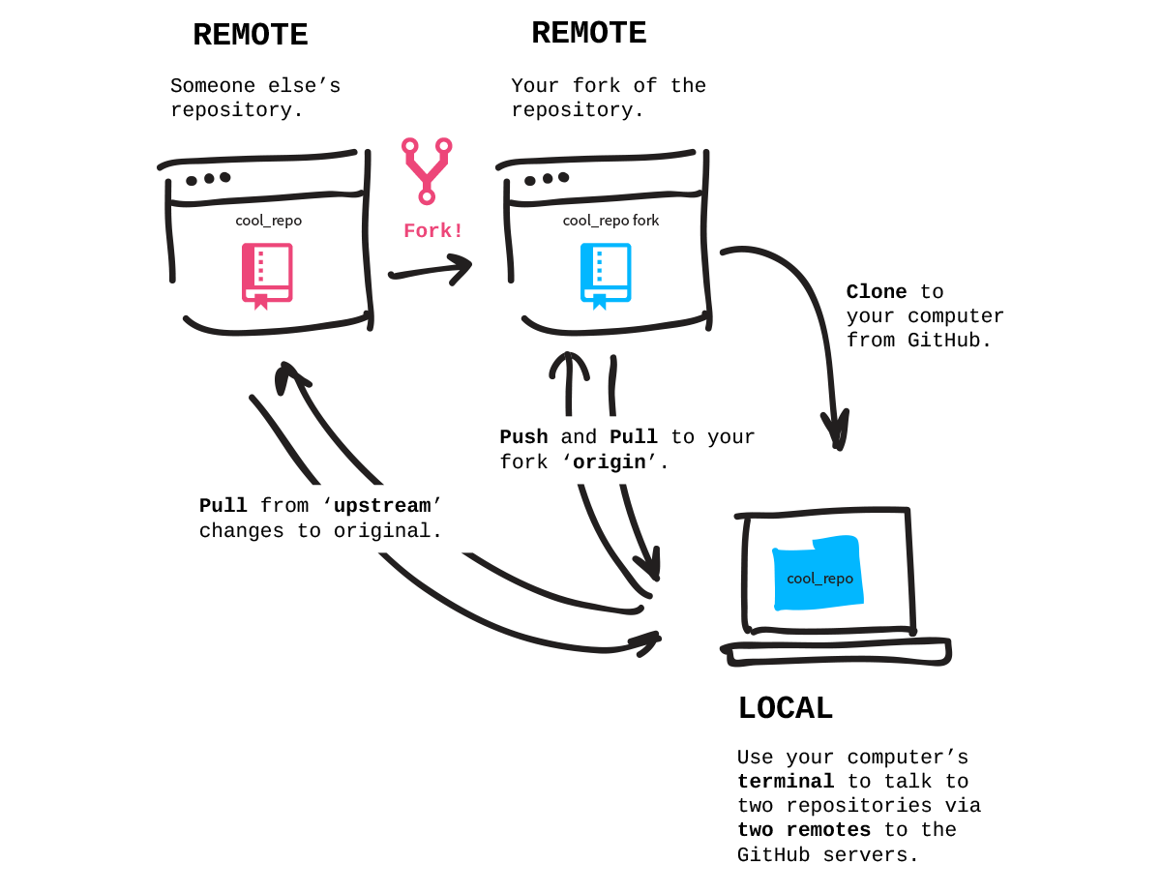
Notes:
On GitHub website: fork it, then git clone to your local computer. In this case, upstream & origin will be two different repositories. Upstream will be the repository of the person who originally created it. Origin will be your forked version hosted on GitHub. Your local repository will have 2 remotes.
https://docs.github.com/en/github/getting-started-with-github/fork-a-repo

Slide 28
Tracking changes
git status
This checks the status of the repo, shows if there are changes locally or on the remote
git pull
Do this before making changes so you don’t have merge conflicts
Update the local repo with the new changes from the remote
git add –A
Puts files into the staging area, the –A flag adds all files with changes
git commit –m “Brief, informative message describing changes made since last commit”
Saves the changes that were staged in the git add command
git push
Send the local changes to the remote repo

Slide 29
Comments on Collaborating
In practice, it is good to be sure that you have an updated version of the repository you are collaborating on (even if it is just with yourself), so you should git pull before making changes.
The basic collaborative workflow would be:
update your local repo with git pull origin main,
make your changes and stage them with git add -A,
commit your changes with git commit –m “short description of changes”
upload the changes to GitHub with git push origin main
It is better to make many commits with smaller changes rather than of one commit with massive changes: small commits are easier to read and review.

Slide 32
Comments on Collaborating
You don’t have to create a fork if there are a small number of people contributing. A lot of times we are the only person contributing to a repo.
Sometimes keeping track of forks & branches can be confusing and ends up leading to you not actually using Git.
You can add someone’s GitHub username as a collaborator on a repo then you can both push/pull to the same remote repository. This will make it so you don’t have to deal with pull requests.

Slide 33
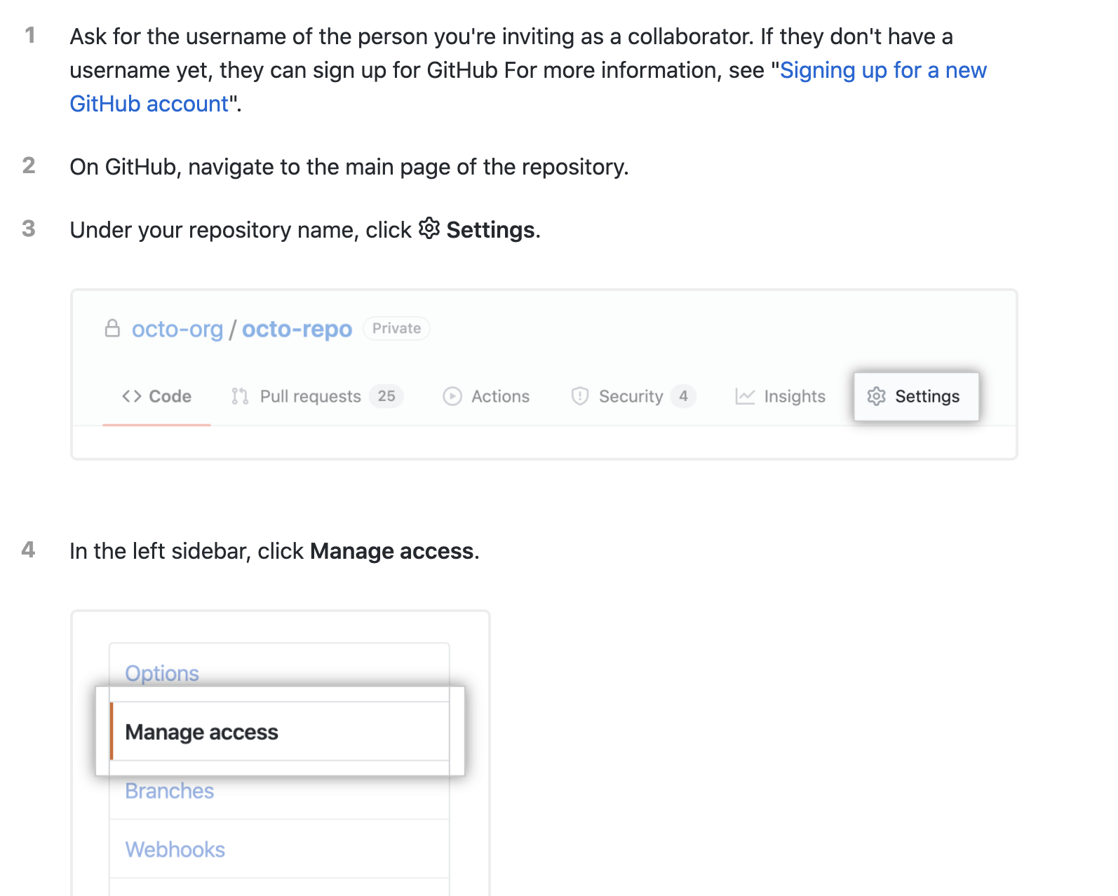
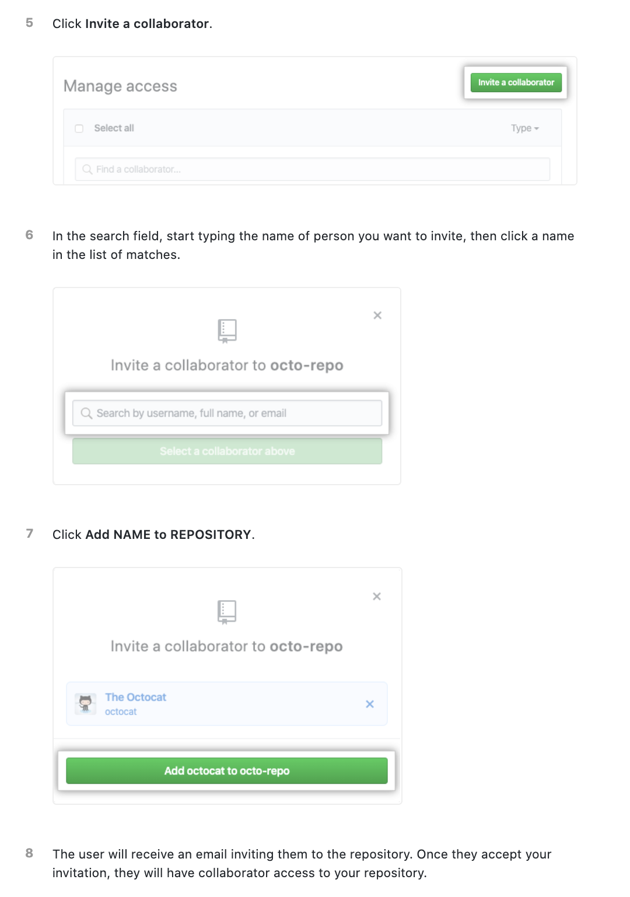

Slide 34
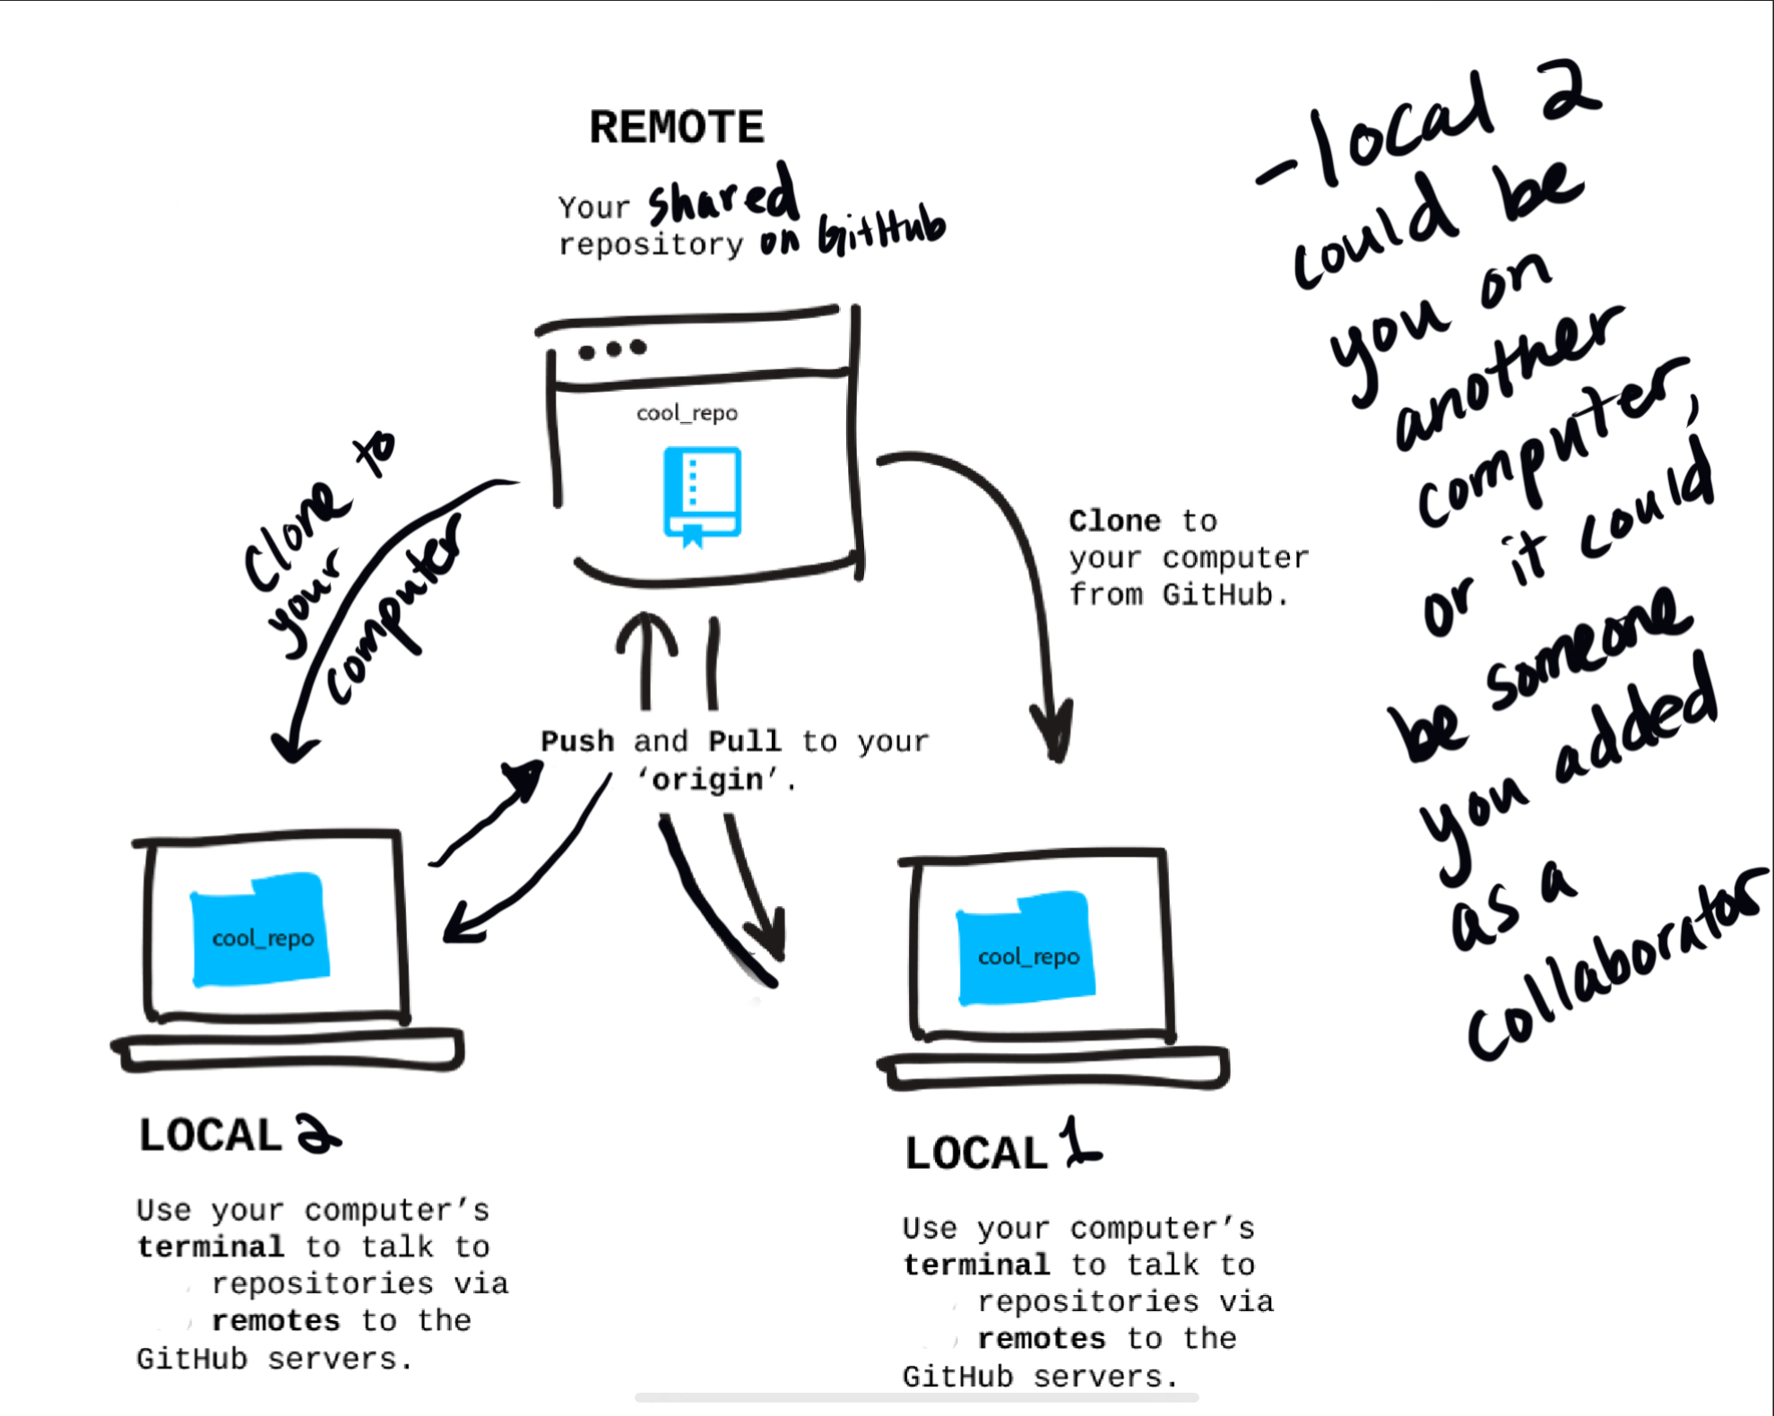

Slide 35
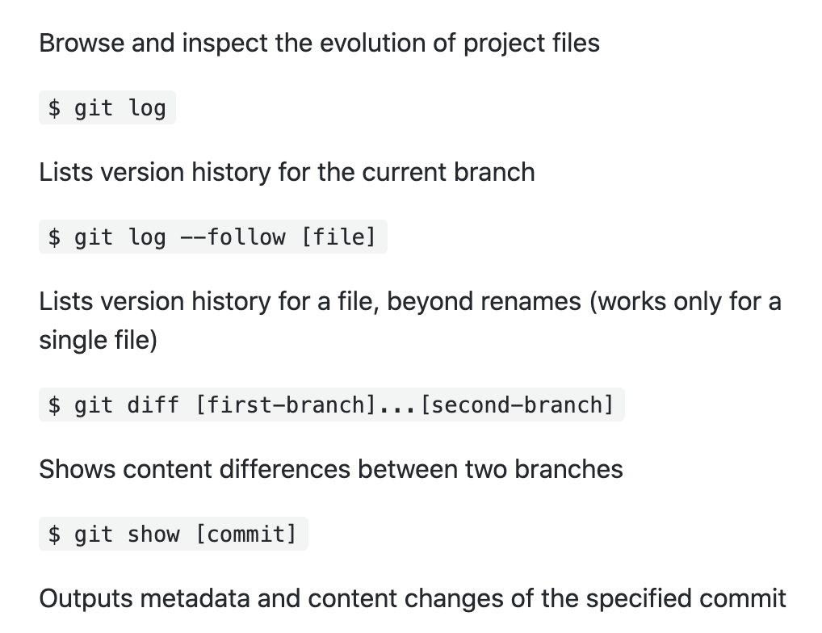

Slide 36
Examples of simple, intermediate, & complex repositories
Simple: https://github.com/saigerutherford/WhistlerPoster2020
Intermediate: https://github.com/saigerutherford/fetal-code
Complex: https://github.com/nipreps/fmriprep
https://github.com/nilearn/nilearn

Slide 37
git-annex
git-annex allows managing files with git, without checking the file contents into git. While that may seem paradoxical, it is useful when dealing with files larger than git can currently easily handle, whether due to limitations in memory, time, or disk space.
https://git-annex.branchable.com/

Slide 38
Dank je wel
@being_saige

